Slide 1
Worried??
Personal Lines – Auto Insurance

Slide 2

Personal Lines - Auto Program
Personal Auto Program : Designed for Vehicle Owners. Vehicles include private passenger car, motorcycles, snowmobiles etc.
The program provides protection for Physical Damage to the vehicle and Liability (Bodily Injury and Property Damage). Apart from these, there can be other towing and labor cost coverage etc.
Personal Auto policy provides coverage for all eligible vehicles and drivers.
Basic coverages : https://www.youtube.com/watch?v=CBmtFPMUcr0
Notes:
Uninsured Motorist: Pays for bodily injury and/or property damage caused by an uninsured motorist (including hit-and-run driver)
Underinsured Motorist: Pays for bodily injury and/or property damage caused by a motorist whose liability insurance is not adequate to pay for damages you are legally entitled to recover.
Medical Payments: No Fault Cover which insures against medical bills that you, your family members, your passengers, or any pedestrians incur as a result of an accident involving your car
Personal Injury Policy: No Fault Cover which pays medical expenses, lost wages and other damages like funeral expenses of the insured, others in his vehicles and pedestrians struck by him. Personal injury protection (PIP) is an extension of car insurance available in some U.S. states that covers medical expenses and, in some cases, lost wages and other damages. PIP is sometimes referred to as "no-fault" coverage, because the statutes enacting it are generally known as no-fault laws, and PIP is designed to be paid without regard to "fault," or more properly, legal liability. That is, even if the person seeking PIP coverage caused the accident, they are entitled to make a claim under the PIP portion of their policy. "No-Fault" does not mean that insurance premium of the person making the claim will not increase. Typically a PIP claim is made by the insured driver to their own insurance company, however, there are several exceptions that allow persons who have been injured in an accident to make a PIP claim if they do not own a vehicle. The particular state law and policy language of the insurer should be reviewed to see what exceptions exist in that state.
Limit : A limit means the maximum benefit of a given insurance policy that the insurance company would pay out in case of a total loss that is payable as a claim.
Split Limit : Split limits restrict the maximum amount that a policy will pay for a specific type of loss, such as property damage and bodily injury. A split limits auto insurance policy, for example, might pay $50,000 per person and $150,000 per accident in bodily injury benefits, and $50,000 in property damage per accident. By contrast, a single limit policy might pay up to $200,000 for all property damage and bodily injury resulting from a single accident. Although the total amount of coverage is the same, the single limit (CSL) policy is more flexible, because it doesn’t cap the amount that can be paid for any type of loss.
CSL – Combined Single Limit is the maximum amount that the insurance company must pay for all damages arising out of a single accident.
Deductible: It's the amount of a claim Insured is responsible for, before the insurance company will start paying it's share of costs.
In automobile insurance coverage, you may select a plan with a deductible of $1,000. This would mean that if you have a collision where repairing the damage would cost $5,000, the insurance company would pay $4,000, while you must pick up the rest.
If you had a minor accident with a scratch that would cost $500 to repair, the insurance company would not have to pay anything. You would have to pick up the repair costs yourself.
https://www.youtube.com/watch?v=-N2c4F_Yiwc
https://www.youtube.com/watch?v=m-0fzR13W9w

Slide 3
Common Personal Auto Coverages:
Liability
Bodily Injury (referred as BI) -Claims for bodily injury may be for such things as medical bills, loss of income or pain and suffering.
Property Damage to others
Physical Damage
Collision : damage to Vehicle caused by collision with an object
Other than Collision (referred as OTC) -
1. Comprehensive 2. SCOL (Specified Cause of Loss)
Uninsured/Underinsured Motorist :
Medical Payments
No Fault or PIP
Towing
Limit- Split Limit/ Combined Limit -> (BI per person: BI per Accident: PD per Acc. :: 50/150/50) / 200
Deductibles
Notes:
What Is Comprehensive Auto Insurance? | Allstate
:https://www.allstate.com/tools-and-resources/car-insurance/what-is-comprehensive-auto-insurance.aspx
Types of Auto Insurance Coverage | Travelers Insurance Personal Auto Coverage :
https://www.youtube.com/watch?v=yJ2iU8XPIRc
https://www.youtube.com/watch?v=F53BOU1ImEU
https://www.youtube.com/watch?v=EDgfqVysHCo
https://www.youtube.com/watch?v=z94_foSJmkA
Limit- Split Limit/ Combined Limit ->
(BI per person: BI per Accident: PD per Acc. :: 50/150/50) / 200
https://www.youtube.com/watch?v=KJnN0yKlRYk
https://www.youtube.com/watch?v=ZzcqNkcc7ZU
https://www.youtube.com/watch?v=pVkppIrByCQ
Deductibles
How Auto Insurance Deductibles Work : Auto Insurance – YouTube
https://www.youtube.com/watch?v=22zNFunwxnk
Understanding Auto Insurance Deductibles - YouTube
https://www.youtube.com/watch?v=SBbYEcmxmt0

Slide 4
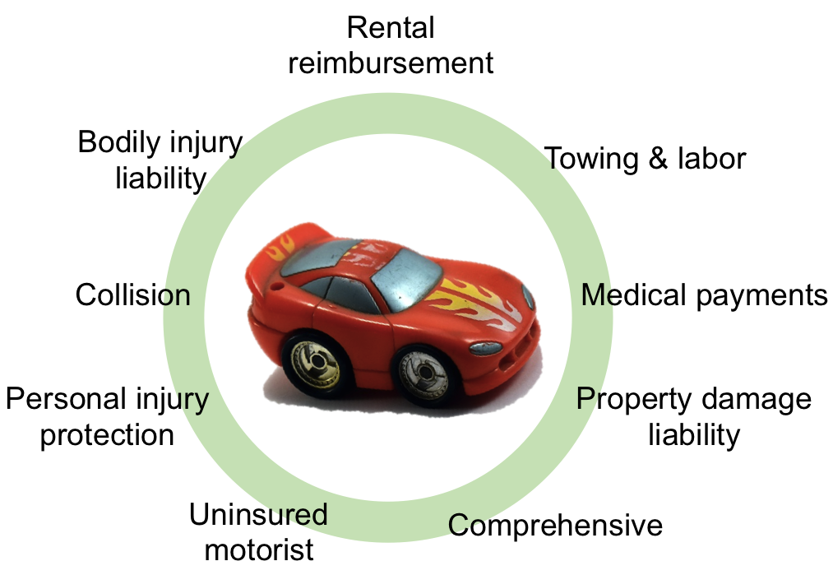
https://psu.instructure.com/courses/1806581/pages/chapter-4-types-of-auto-insurance-coverage
Notes:
Bodily injury liability - it is defined per person and per accident
Property damage liability - it is defined per accident and covers damage that you become responsible for, not damage to your own car
Personal injury protection - it is defined per person and per accident and may include limits to medical and other expenses
Collision - it covers repair or replacement of your car in case of damage caused by an accident
Comprehensive - it covers repair or replacement of your car in case of damage NOT caused by an accident
Medical payments - it covers your medical expenses and could be limited
Uninsured motorist - it covers you and your car if you get hit by uninsured motorist (someone driving without insurance)
Rental reimbursement - it covers a rental car and could be limited to specific situations and time span
Towing and labor - it covers towing and labor on your car and could be limited to specific cases
https://psu.instructure.com/courses/1806581/pages/chapter-4-types-of-auto-insurance-coverage

Slide 5
The personal automobile policy (PAP) is the automobile insurance contract purchased by most individuals.
It begins with :
a declarations page,
general insuring agreement,
list of important definitions,
followed by the policy’s six major parts.
Part A—Liability coverage
Part B—Medical payments coverage
Part C—Uninsured motorists' coverage
Part D—Coverage for damage to your auto
Part E—Duties after an accident or loss
Part F—General provisions
https://slideplayer.com/slide/13871052/
Notes:
six major parts.
Part A—Liability coverage
Part B—Medical payments coverage
Part C—Uninsured motorists coverage
Part D—Coverage for damage to your auto
Part E—Duties after an accident or loss
Part F—General provisions

Slide 6
Do Watch…
Liability Coverages : Bodily Injury Liability Coverage | Liberty Mutual:
https://www.libertymutual.com/auto/car-insurance-coverage/bodily-injury-liability ,
https://wallethub.com/edu/liability-car-insurance/7300/
Physical Damage : What Is Comprehensive Auto Insurance? | Allstate :
https://www.allstate.com/tools-and-resources/car-insurance/what-is-comprehensive-auto-insurance.aspx
Uninsured/Underinsured Motorist : http://businessinsure.about.com/od/commercialauto/a/Insuring-Non-owned-Autos.htm
Medical Payments : https://wallethub.com/edu/med-pay/9255/
No Fault or PIP : How PIP Insurance Work - https://wallethub.com/edu/pip-insurance/9248/
Limit- Split Limit/ Combined Limit : https://www.youtube.com/watch?v=KJnN0yKlRYk
Deductibles : How Auto Insurance Deductibles Work : Auto Insurance – YouTube
Visit without fail

Slide 7
Common Personal Auto Coverages: Scenarios
The Role of Your Insurance and Other Parties Insurance When Multiple Parties Are At Fault: http://www.jasonschultzpc.com/blog/the-role-of-your-insurance-and-other-parties-insurance-when-multiple-parties-are-at-fault.cfm
Multiple Family Members In One Car Accident
http://www.lombardilaw.com/blog/how-do-multiple-passengers-split-the-limits-of-auto-insurance-.cfm

Slide 8
Personal Vs Commercial Auto Insurance
The Difference Between Personal and Commercial Auto Insurance ...
https://www.youtube.com/watch?v=LYH37mGcHZw
https://www.youtube.com/watch?v=lW4MQm2BO4E
https://www.youtube.com/watch?v=60YFGiqosxo

Slide 9
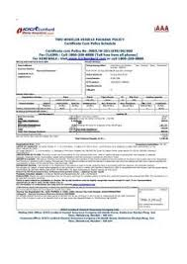

Slide 10
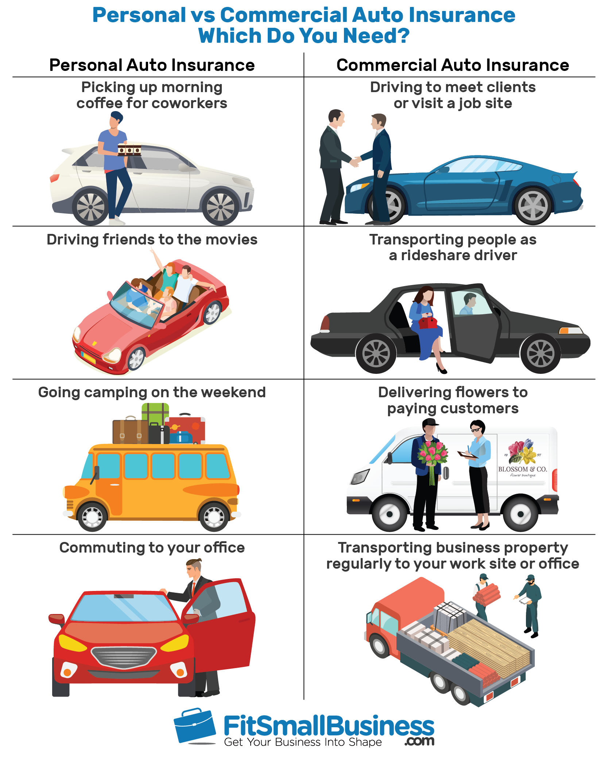
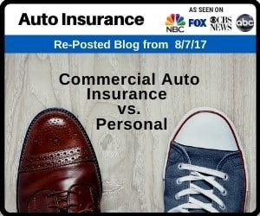
https://fitsmallbusiness.com/commercial-vs-personal-auto-insurance/

Slide 11
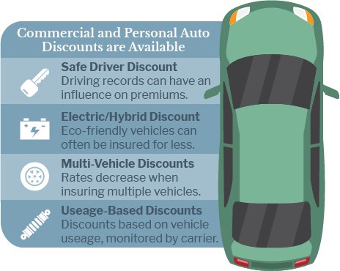
https://www.insuranceshopllc.com/business/coverage/commercial-auto.php

Slide 12
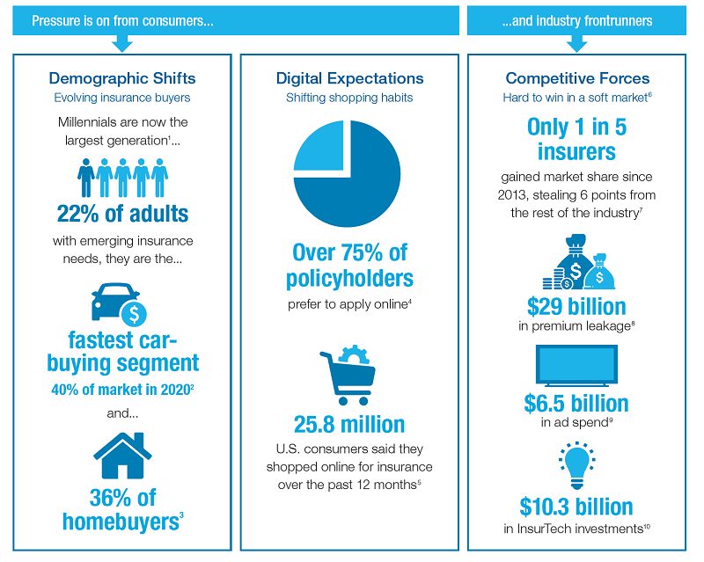
https://www.verisk.com/insurance/visualize/where-is-the-personal-auto-market-and-how-did-we-get-here/

Slide 13
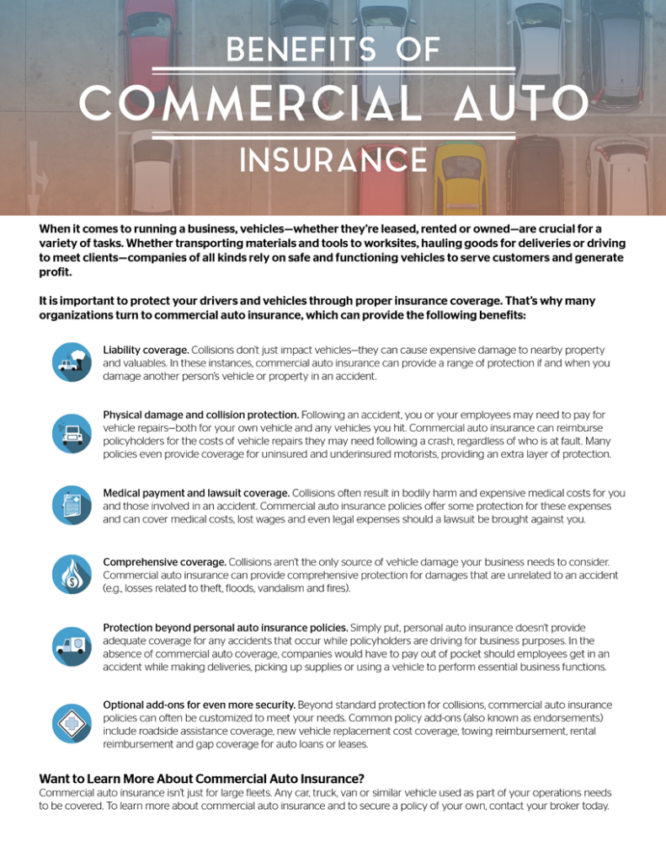
https://www.swampfoxagency.com/benefits-of-commercial-auto-insurance/

Slide 14
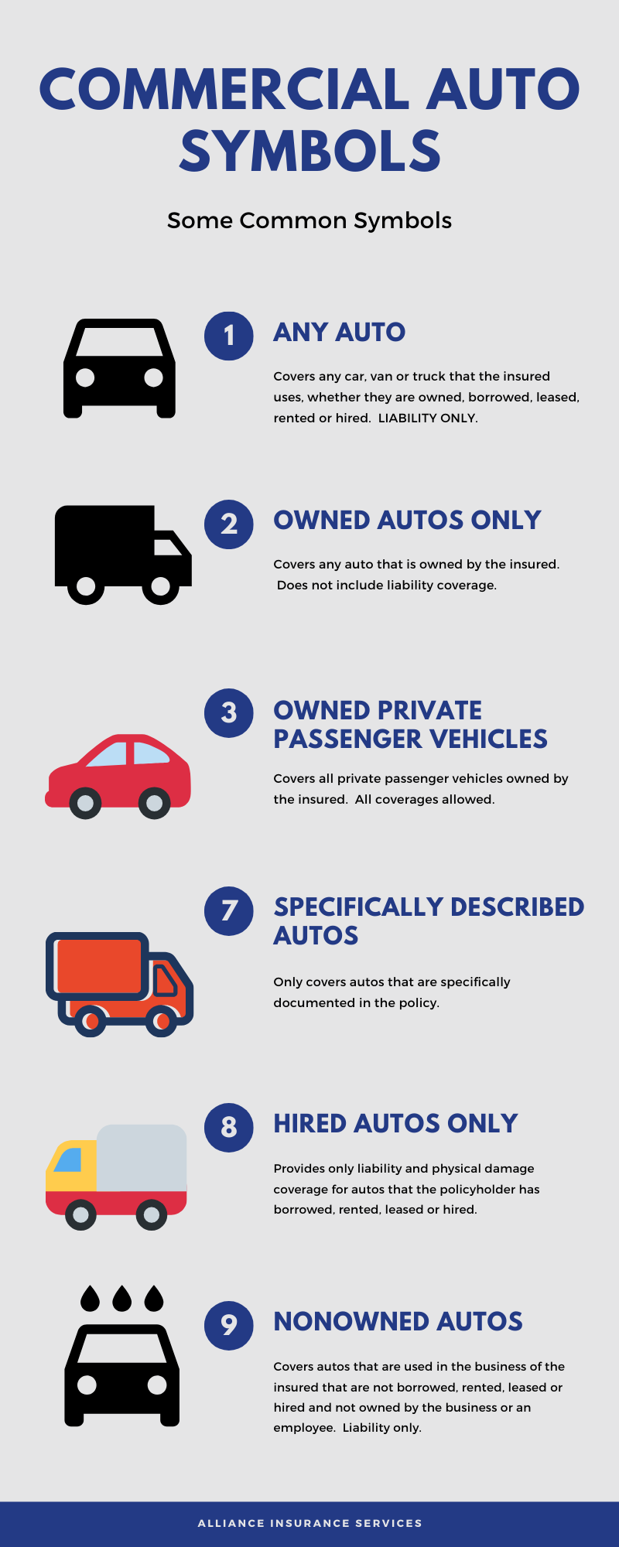
https://www.myallianceinsurance.com/how-to-rock-commercial-auto-insurance-in-north-carolina/

